Slide 1

Noname finance
Team NoName

Slide 2
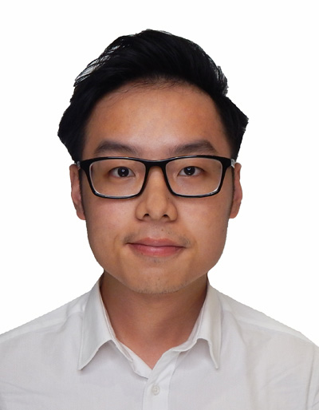
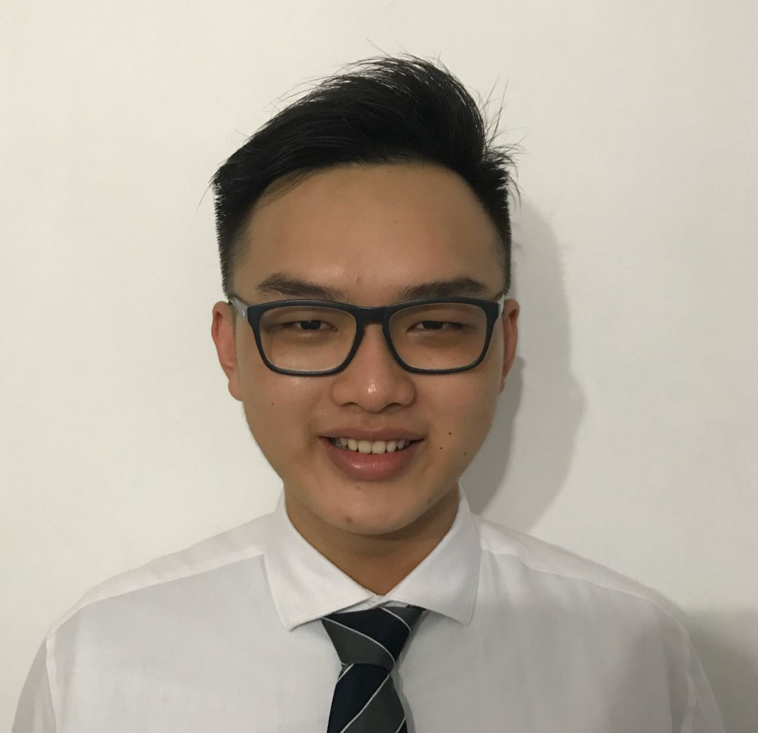

OUR TEAM
DICK
FRANS
JIA MIN
SIS | Business Analytics
SIS | Software Development
SOB | Marketing Analytics
SIS | Software Development

Slide 3
MEET BRANDON.
Have disposable income, Wants to build up his retirement nest (which is impossible with bank’s negligible interest)
Skeptical about
financial planners >>
Prefers to make his own decision
MAIN GOAL
BELIEFS
Too time-consuming and tedious for information search
Moderate risk appetite,
Low attention span,
Highly sociable and well-connected >>
Always hear stock recommendations from friends
MAIN BARRIER
PERSONALITY

Slide 4
Pain point
OUR SOLUTION
Information is Everywhere
Having to go multiple sources for information gathering.
Difficult to synthesize the scattered information to make an informed investment decision.
One-Stop Information
Youths will be able to gather all the necessary information with just a single search on the company.

Slide 5
KEY FEATURES
ALL IN ONE PAGE
NEWS
SENTIMENTS ANALYSIS
FINANCIAL INFORMATION
Retrieves the top 5 most recent news articles
Conduct a sentiment analysis on the news article
Displays the financial and stock information in an intuitive manner

Slide 6








SOLUTION ARCHITECTURE
Ticker Mapping System
Interactive Chart
Platform
Financial Info Indexing
News Search Engine
Sentiment Analysis Processor

Slide 7
Technology used
DJANGO FRAMEWORK
YAHoo finance api
GNEWS API
MEANING CLOUD API
01
02
03
04
Retrieve data from External API and provide endpoints for frontend
Retrieve financial and stocks information
Retrieve news articles based on company
Perform sentiment analysis on news articles

Slide 8
VALUE OF OUR SOLUTION
HASSLE FREE INFORMATION SEARCH
Only information required
- stock ticker
CENTRALISED INFORMATION
Dynamic
All the necessary information in 1 page
Real-time information is retrieved

Slide 9
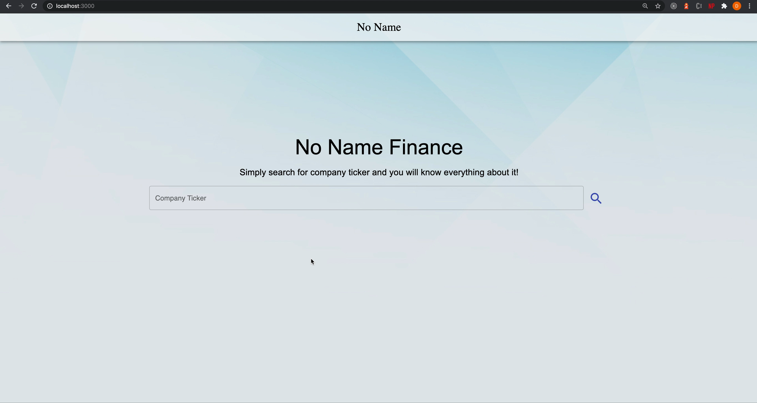
demo

Slide 10
NO NAME
THANK YOU

